Slide 1
Cape Breton University Shannon School of Business
March 30, 2021
Payroll Management System
Course: MGSC 5106
Professor: Enayat Rajabi
Submitted by: Ajay Pratap Singh Rathore
Jinal Ajay Patel
Kristine Mae Pogoy

Slide 2

Cape Breton University Shannon School of Business
Contents
Background
Description
ER diagram
Relational model
MySQL tables
MySQL queries
March 30, 2021

Slide 3
Cape Breton University Shannon School of Business
Background
Problem Statement
Employees were receiving hard copies of payslips
Longer time to print and receive those hard copies
Solution
Company is upgrading its payroll management system making it fully automated
Online access to payslips for all employees anytime through a front-end internal website
No wait time for payslip generation
March 30, 2021

Slide 4
Cape Breton University Shannon School of Business
Description
Red : Entity
Blue : Attribute
Green : Relationship
Employees are having Employee ID, Employee Name, Designation, Phone number, Address, Postal Code and Bank Account number which works for Department, which are having Department ID and Department Name. Each Employee who is works for a Department includes Date of Joining, Date of termination and Type of Employment (Fulltime/Part-time)
Employees can take multiple leaves with timestamp to and from. Specific leaves (sick leave) can be taken by many employees. Leaves contains Leave ID and Type of leave. Employees monthly working days are calculated based on the number of leaves and its reason
Every month of the year an employee receives Salary which includes – Transaction ID, Net Income and Gross Income. Employee will get a salary once a month.
March 30, 2021

Slide 5
Cape Breton University Shannon School of Business
Description
Red : Entity
Blue : Attribute
Green : Relationship
Deductions, Allowances and Compensation will be based on each employees designation. Zen Tech’s Account department will calculates it
Deduction in Salary have Deduction ID, Income Tax, Professional Tax, Loan and Pension funds
Every month of the year an employee receives Salary which includes – Transaction ID, Net Income and Gross Income. Employee will get a salary once a month
Allowances have Allowance ID, Medical Allowance, House Rent Allowance and Travel Allowance. Employees will get credentials on their email address to get benefit of Allowances to reduce Taxes
Compensation have Compensation ID, Bonus and yearly Appraisal
March 30, 2021

Slide 6
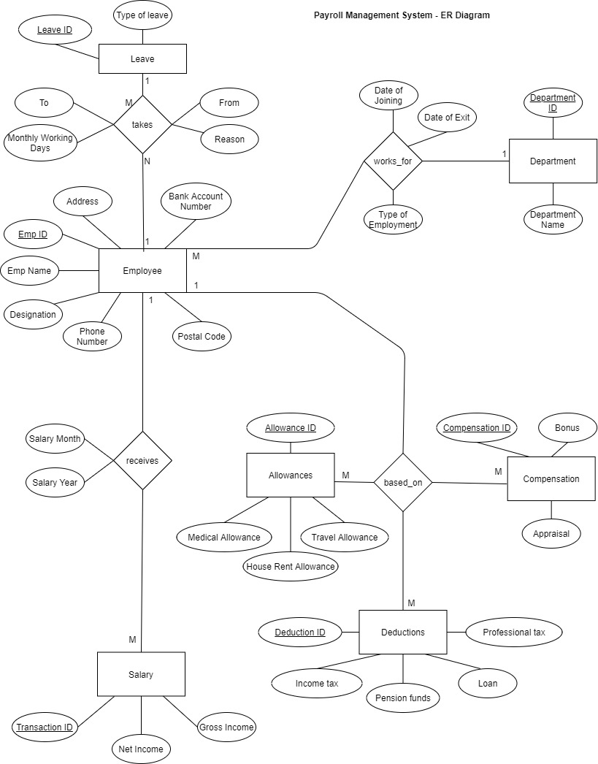
Cape Breton University Shannon School of Business
ER Diagram
March 30, 2021

Slide 7
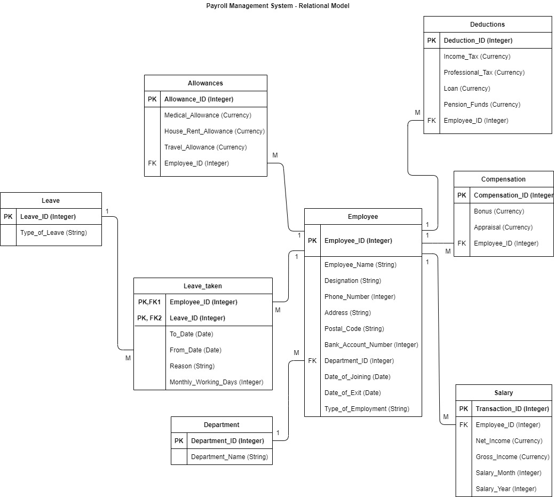
Cape Breton University Shannon School of Business
Relational Model
March 30, 2021

Slide 8
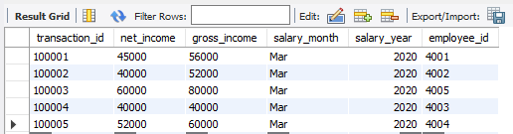
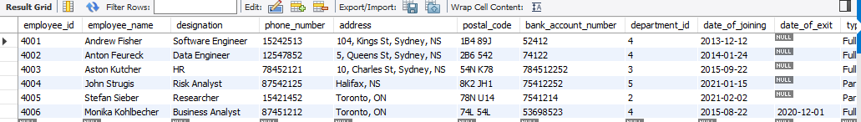
Cape Breton University Shannon School of Business
MySQL Tables
Salary Table
Employee Table
March 30, 2021

Slide 9
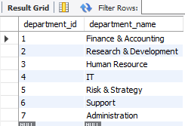
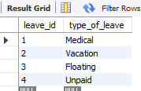
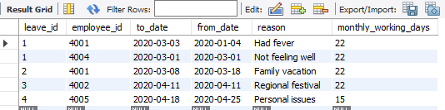
Cape Breton University Shannon School of Business
MySQL Tables
Department Table
Leave Table
Leave Taken Table
March 30, 2021

Slide 10
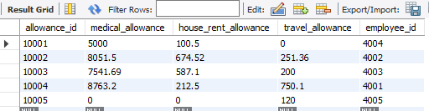
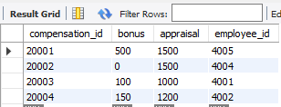
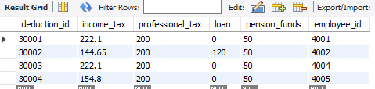
Cape Breton University Shannon School of Business
MySQL Tables
Allowance Table
Compensation Table
Deduction Table
March 30, 2021

Slide 11
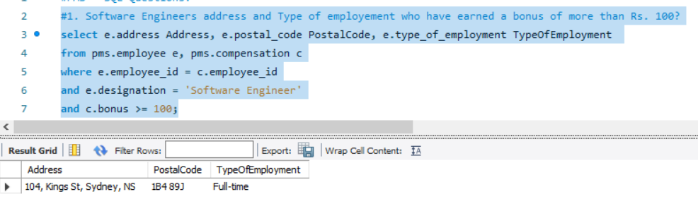
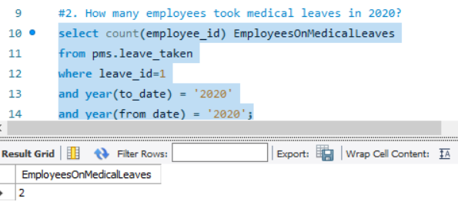
Cape Breton University Shannon School of Business
MySQL Queries
March 30, 2021

Slide 12
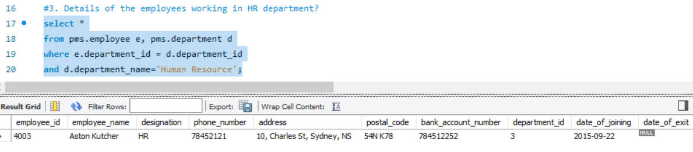
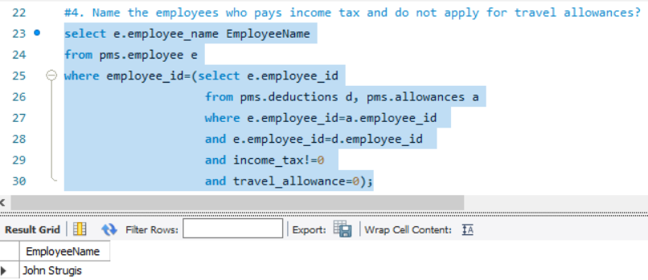
Cape Breton University Shannon School of Business
MySQL Queries
March 30, 2021

Slide 13
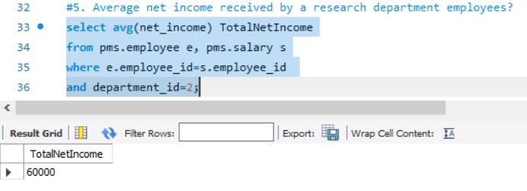
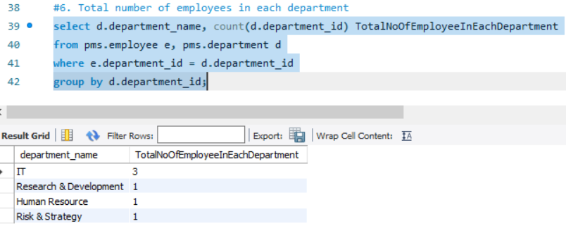
Cape Breton University Shannon School of Business
MySQL Queries
March 30, 2021

Slide 14



Data is the new OIL!
Thank You

